Slide 1

: CENTRAL EUROPEAN EXPERTS
IN KNOWLEDGE MANAGEMENT
March 2014

Slide 2

We have been instrumental in Slovakia‘s efforts to build knowledge-based economy
2015-2020
Science parks
2011-2015
Larger industry- academia consortia
Greater industry-academia synergies
2009-2012
Industry-academia research centers
2008-2012
Centers of
excellence
2007: Slovakia had declining innovation outputs and irrelevant results

Slide 3







We have a large network of top scientists and universities
Sample of our closest long-term university clients
Helped secure over €250 million in funding (excluding investments into new buildings)
Worked with top scientists to design centers of excellence, indus-try-academia cooperation consortia and technology transfer offices

Slide 4
Our consulting projects aim to build and strenghten R&D ecosystems for the long-term
World-class research
Marketable cutting edge research
Current research capabilities
Industry needs

Slide 5
We have extensive experience in the design and implementation of R&D and commercialization activities in Eastern Europe
1
Comprehensive
R&D infrastructure
2
Design and management of effective technology commercialization systems
3
Technology investment bridge between Russia and Silicon Valley
We design the entire R&D ecosystem, including scientific institutes, companies, universities, and TTCs.
We manage IP rights, support startups and spin-offs and manage relations between business and academia.
We enable startups to take advantage of both the low costs in EE and the nurturing environment of Silicon Valley.
Credentials
Credentials
Credentials
Recent authorship of EBRD study on Science and Technology Parks (STPs) in Russia, gathering extensive contacts among key stakeholders
Designers of and successful funding seekers of around €200 million for academic-business research centers and science and technology parks
Executive experience as chief architects of Slovakia’s national knowledge-economy reforms
Projects with universities in building their technology transfer centers
Neulogy’s innovative model of building and supporting technology startups arising from the R&D community in Eastern Europe
Office in Silicon Valley with extensive contacts among the VC community, including Russian-oriented VCs
Neulogy’s model based on separating startups and spin-offs into a product development group that stays in Eastern Europe and a business development group that takes advantage of the inspiring experience of a Silicon Valley incubator
Other credentials
Intimate understanding of public sector mindsets and issues in the Eastern European context (team members worked in leading positions in private and public sector in Eastern Europe)
Extensive working experience in diverse post-communist countries, including Russia, Serbia, Slovakia and Czech Republic
Vast contact base among Central European scientists who could come work in Skolkovo
Team of highly experienced professionals that includes former top public officials and graduates of leading universities such as Stanford, Harvard, Princeton and Columbia
© Neulogy

Slide 6
Neulogy is uniquely positioned to generate a strong pipeline of technology based spin-offs and start-ups in the wider Central European region
Clean technology
Biotechnology
IT
Automotive
Neulogy’s areas of focus
Neulogy’s partners
All major Slovak universities
Slovak branches of multinational companies
First private company in Central Europe to specialize in professional services in science and technology
Uniquely positioned to generate a strong pipeline of technology based spin-offs and start-ups in Slovakia and wider Central European region, including Czech Republic, Hungary and Serbia.
EBRD in Russia
Kista and Turku science parks (Sweden, Finland)
Stanford and U. of Texas technology transfer offices
© Neulogy

Slide 7
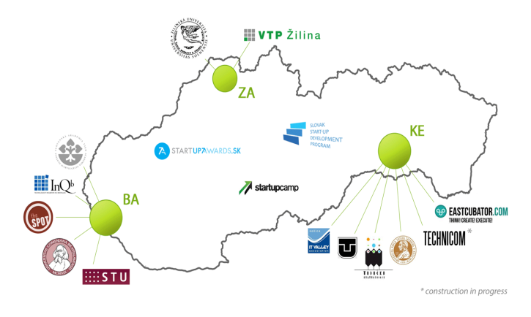







Strong foothold in local innovation and R&D ecosystem
© Neulogy

Slide 8

As a result of these relationships, we have the strongest pipeline of innovative companies in Slovakia
Great partnerships with academic institutions
Strong push towards emerging startup community
Strong pipeline of innovative companies

Slide 9




In addition, we act as a virtual incubator for innovative Slovak startups
Sample of companies that we incubate
Helped secure funding from public and private sources for all of these companies
Designed strategic, business and marketing plans
Applied for patent protection in the United States and Europe

Slide 10

Neulogy Ventures: source of venture capital funding for university spin-offs and SMEs
strong pipeline of business ventures and innovative ideas missing financing
Slovak leader in R&D and startups
Venture capital company managing 25+ mil. EUR

Slide 11




Neulogy Ventures: two funds covering financial needs from seed to expansion stage
Slovak Innovation Fund
Slovak Entrepreneurs Fund
Investment range
€50K to €200K (Seed and Early-stage)
Fund size
€ 7.3 mil.
Source of money
Public (EIF)
Geographic focus
Slovakia
Sectoral focus
ICT/ Energy / Medical diagnostics
Eligible companies
Innovative technology/service
Strong competitive advantage
Global potential and large market
Dedicated and passionate founder
Viable exit strategy (within 3-6 years)
Investment range
€300K up to €3 mil. (Late stage)
Fund size
€ 16.1 mil.
Source of money
Private (majority) and public (EIF)
Geographic focus
Slovakia
Sectoral focus
ICT/ Energy / Medical diagnostics
Eligible companies
Product or service commercially available
Strong revenue growth (close to/already profitable)
Commercial partnerships already established
Feasible growth plan
Seeking money to accelerate expansion

Slide 12

StartupAwards.SK , a true celebration of creative minds and innovative ideas
What is it?
StartupAwards.SK is the largest competition of innovative projects and companies (start-ups and spin-offs) from Slovakia
Goals:
Connect world-class projects with investors and support technology transfer
Motivate students and youngsters towards entrepreneurship and creation of new businesses
Popularize Slovak inventions abroad as well as among the general public
Impact:
Educational activities and roadshows across the foremost Slovak universities and innovation hubs
Thousands of spectators, hundreds of applying projects
Preparation of finalists for investor pitch at the two-day long mentoring&couching session (Bootcamp)
Invaluable experience and prizes designed to boost winning projects
Fostering young companies

Slide 13
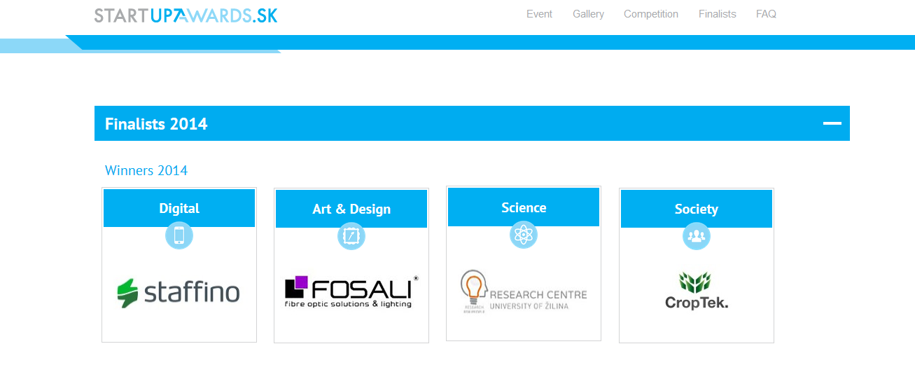

Slide 14

Visegrad countries cooperation – joint platform in Silicon Valley
What is it?
V4 – Silicon Valley Tech Match event, April 21-23, 2015
www.visegradstartups.com
Goals:
Bring 12 startups from Visegrad countries to Silicon Valley
Enhance visibility of the innovation & startup potential within V4 countries abroad
Position the Visegrad concept of cooperation within the startup ecosystems
Raise awareness of the need for closer cooperation among Visegrad countries
Establish a Visegrad platform for startups in Silicon Valley
Impact:
First-ever cooperation of Visegrad countries related to startups
Showcase for a more structured and systematic collaboration

Slide 15
We welcome offers for cooperation and partnerships
Petra Lipnicka
Chairwoman, Neulogy
Ilkovicova 2, Bratislava
841 04 Slovakia
+421 254 414 100
lipnicka@neulogy.com

