Slide 1


Slovak Centre of Scientific and Technical Information
Technology Transfer in Slovakia
Miroslav Kubiš
SLOVAKIA INDUSTRY AND KNOWLEDGE TRANSFER
Bratislava, 24th March 2015

Slide 2




Summary
Slovak Centre of Scientific and Technical Information
  Basic Information
Technology Transfer at Slovak Academic Institutions
  Current Situation
TT and National Support Services for Slovak Academic Institutions
  Intellectual Property Rights Protection
  Intellectual Property Commercialisation
TT and National Support Services for SMEs
  Intellectual Property Rights Protection
NITT SK National EU Structural Fund Project
  Short Description
NPC National EU Structural Fund Project
  Short Description

Slide 3
Slovak Centre of Scientific and Technical Information
National information centre and specialised scientific library
Operation of state systems and repository in the field of science
(SK CRIS, Publication Activity, Antiplagiarism system, …)
National centre for promotion of science and technology
Technology transfer centre with nation-wide operation
Patent Library Bratislava – PATLIB
Depository library of OECD, EBRD and WIPO
Network of National Contact Points for HORIZON 2020 programme
Slovak Liaison Office for R&D in Brussels (SLORD)
From January 2014 – information and prognoses in education

Slide 4
Technology Transfer at Slovak Academic Institutions
Mostly lacking in experience with TT
Small but growing interest in IP and its commercialisation
  in management of institutions
  in scientific staff
Technology Transfer Offices founding
  different importance - 1 – 4 workers
  different area of interest (depends on TTO staff skills)
Implementation of TT-related policies
  from formal fulfilment in the past to real implementation now
Growing number of technologies legally registered by academic institutions
  up to 40 – 50 cases per year evaluated for patent protection (0 – 10 in the past)
Major work was done in past two or three years

Slide 5
TT and National Support Services for Slovak Academic Institutions
Project - National infrastructure for Supporting Technology Transfer in Slovakia – NITT SK (implemented by SCSTI from 2010)
  Provides support services to academic institutions at national level
    Invention monitoring and identification of IP
    Evaluation of IP, patent searches, IP advisory services and consultancy
    IP protection – patent applications, IP protection strategy
    Marketing presentations of technologies and partners searching
    Preparation of all kinds of necessary agreements, licensing, spin-offs founding
    TT process coordination
    Part of services provided directly by the TTO staff at SCSTI, another part delivered by external experts hired by TTO at SCSTI
    Patent fees payment

Slide 6
TT and National Support Services for Slovak Academic Institutions
Project - National Infrastructure for Supporting Technology Transfer in Slovakia – NITT SK (implemented by SCSTI from 2010)
  Preparation of establishment of the Slovak National Technology Transfer Office
    will manage the national “Patent Fund”,
    will group all academic institutions via their representatives,
    will provide expert services in TT process for academic institutions,
    will define conditions for allocating finance from “Patent Fund”,
    will set up minimum standards for TT process management,
    will become a platform to create a systematic approach to TT in Slovakia.

Slide 7
TT and National Support Services for SMEs
Project - National Business Centre in Slovakia – 1st phase (implemented by SCSTI from 2014)
  Preparing establishment of the National Business Centre in Slovakia (NBC)
  Will provide similar services related to IP as the SNTTO provides for academic institutions, especially:
    Identification of IP – using EPO processes for SMEs
    Evaluation of IP, patent searches, IP advisory services and consultancy
    IP protection – patent applications assistance, IP protection strategy
  Preparing an IKT system for searching co-operations between academic institutions and enterprises
    Profiles of scientific departments, information on projects and technologies on both sides – academic and commercial
    Merging of activities

Slide 8

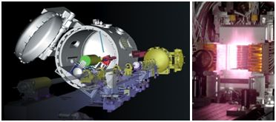

NITT SK
http://nitt.cvtisr.sk
National Infrastructure for Supporting Technology Transfer in Slovakia – NITT SK
IMPLEMENTATION
6/2010 – 12/2014
prolonged up to 10/2015
BUDGET
€8,234 571.17
WWW.NPTT.SK
Supporting research activities in Slovakia / Project is co-financed by the EU

Slide 9
PROJECT OBJECTIVES
http://nitt.cvtisr.sk
GENERAL OBJECTIVE
The project’s primary objective is to propose and put into effect the national infrastructure to support technology transfer, and thus contribute directly to more intensive and efficient state support to research and development.
Specific objective no. 1
To establish a Technology Transfer Centre at the Slovak Centre of Scientific and Technical Information in order to ensure systematic support for the technology transfer at national level.
Specific objective no. 2
To assist the scientific community in the process of technology transfer via utilisation of the existing capacities and resources of the research and development information and communication technology infrastructure.
Specific objective no. 3
To render the process of the transfer of scientific knowledge and technology into the economy and society more efficient through the popularisation of science.

Slide 10



NPC
NATIONAL BUSINESS CENTRE
http://npc.cvtisr.sk
Establishment and Development of National Business Centre in Slovakia – 1st phase
IMPLEMENTATION
6/2014 – 10/2015
BUDGET
€9,989 602.86
PARTNER
Slovak Business Agency
Supporting research activities in Slovakia / Project is co-financed by the EU

Slide 11
PROJECT OBJECTIVES
NATIONAL BUSINESS CENTRE
GENERAL OBJECTIVE
Establishment of National Business Centre as an interface for entrepreneurs, R&D and academic institutions
Specific objective no. 1
To intensify R&D co-operation between academia and industry, and enhancing innovation activities of technology-based SMEs
Specific objective no. 2
Creation of NBC in Bratislava with the aim to provide the comprehensive support to innovative SMEs, including coordinated support for potential R&D transfer into the business practice

Slide 12
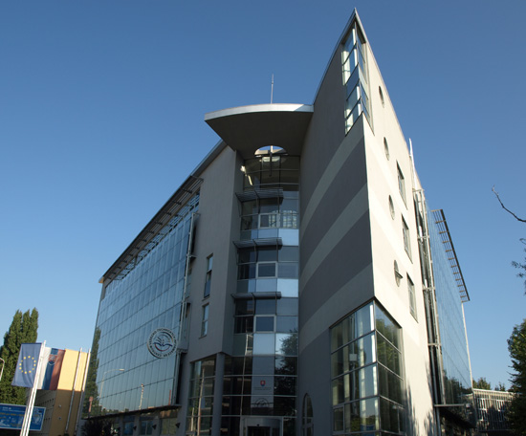
Contact
CVTI SR
Lamačská cesta 8/A
811 04 Bratislava
Slovakia
Miroslav Kubiš
Head of TT Department
Tel: +421 2 69253 110
Fax: +421 2 69253 180
E-mail: miroslav.kubis@cvtisr.sk
www.cvtisr.sk

